Slide 1
Repetition

Slide 2
Repetition
We use repetition to prevent typing the same code out many times and to make our code more efficient.
FOR is used when you know how many times you want to do something, WHILE is used when you don’t.

Slide 3
FOR Loops
FOR is used when you know how many times you want to do something.
Start
x = 1
x < 12
The following program will output the multiplication table for 7 from 1 up to 12 ‘times’.
No
Yes
Display x*7
x = x + 1
End

Slide 4
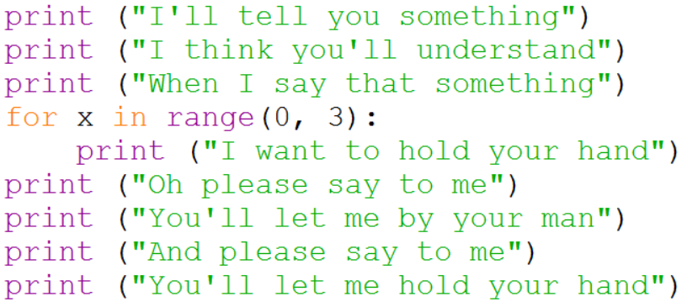
Example
Below is a program developed to output the lyrics of the Beatles song ‘I Want to Hold Your Hand’. Write a program to output the lyrics of your favourite song using a For loop for repeated lines.

Slide 5

Loop Counter
The variable x in a for loop is used as a loop counter. It contains the number of times the loop has run.
See this for yourself by trying out this code:

Slide 6
WHILE Loops
FOR is used when you know how many times you want to do something, WHILE is used when you don’t.
Start
Input Password
The following program keeps on asking the user to enter their password until they enter it correctly.
password
<>
realpass
No
Yes
Display “Correct”
End

Slide 7
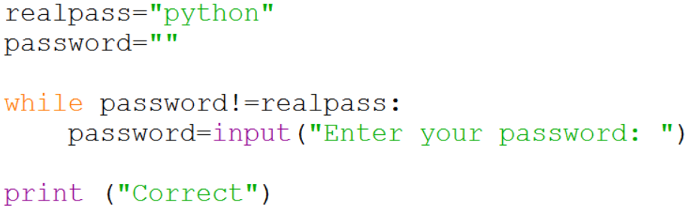
Example
The following program keeps on asking the user to enter their password until they enter it correctly. Try it for yourself.

